Slide 1
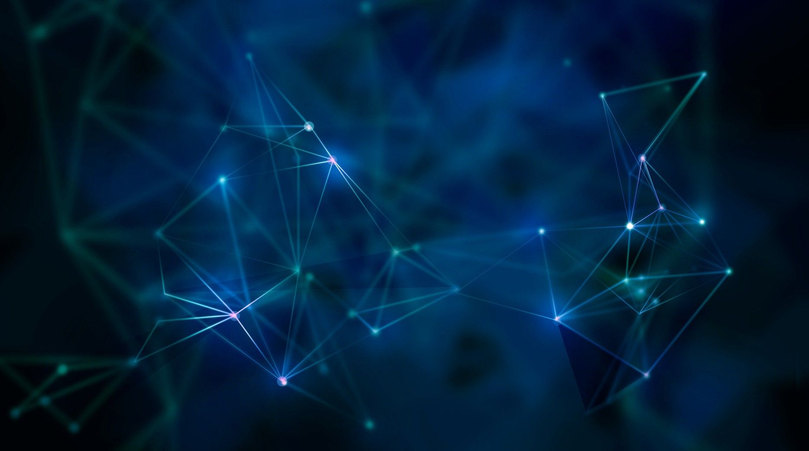
GAN’s
Ganapathi Subramanyam Jayam
Balaji D

Slide 2

AGENDA
About GAN’s
Working of GAN’s
Steps to implement GAN’s
Complete Math of GAN’s
Types of GAN’s evolved
Application of GAN’s
GAN’s using MISI Fashion dataset

Slide 3
Generative Adversarial Network
Ian Goodfellow
Generative- Unsupervised Learning Approach
Adversarial- Model is trained in Adversarial
Network- Neural Networks
GAN’s Architecture consists of:
Generative Network
Discriminative Network

Slide 4
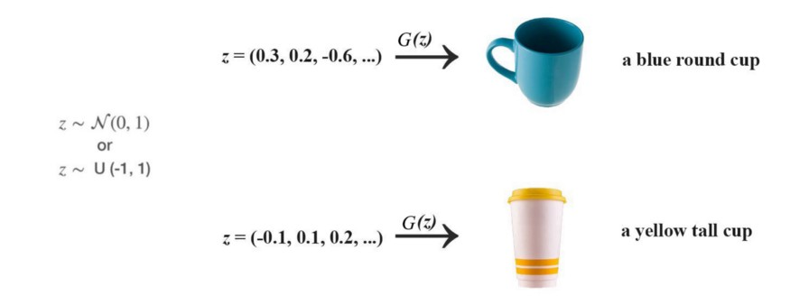
Working of GAN’s
The main focus for GAN (Generative Adversarial Networks) is to generate data from scratch, mostly images but other domains including music have been done.
Generator and Discriminator:
GAN composes of two deep networks one is generator and other is discriminator, Firstly we will talk about how generator works and how it generates images:First we sample some noise Z using either normal (0-1) or uniform (-1 - 1) distribution, with z as input we use a generator G to create an image x (x=G(z))

Slide 5
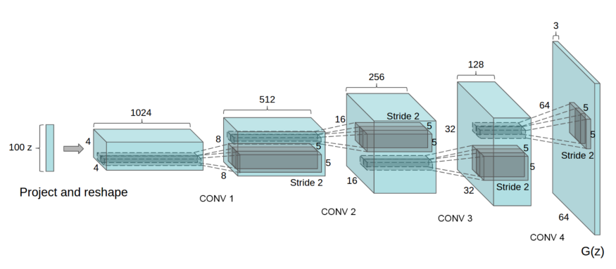
Here, as we know that in deep learning classification we don't control the features of the model is learning, the same thing is applicable to GAN we let the training process to learn it. Now coming to the structure of the generator there can be many design structures one can create as many as hidden layers they wish to perform the training on depending on their requirements, but one of the most popular designs of the generator is DCGAN(deep convolutional generative adversarial networks).it mainly composes convolution layers without any max pooling or fully connected layers.

Slide 6
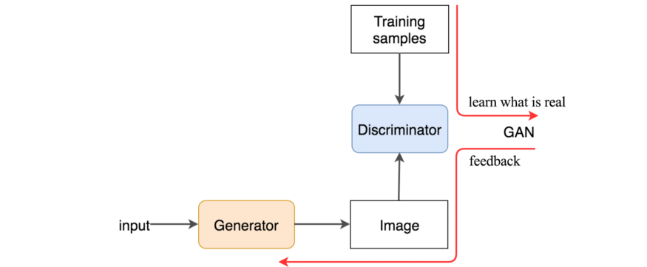
Generator alone creates just a random noise we need discriminator that providence guidance to the generator on what images to create.
The discriminator looks at real images and generated images separately, it distinguishes the image is generated or real. We train the discriminator just like the neural networks, if the input is real we want D(x)=1,if it is generated it should be zero. On the other hand we want generator to create images with D(X)=1, so we train the generator by back propagating the value back to the generator from discriminator.

Slide 7
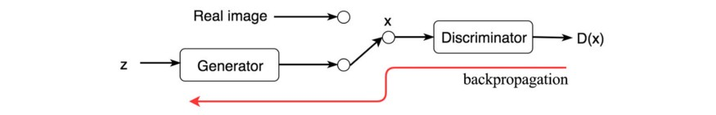
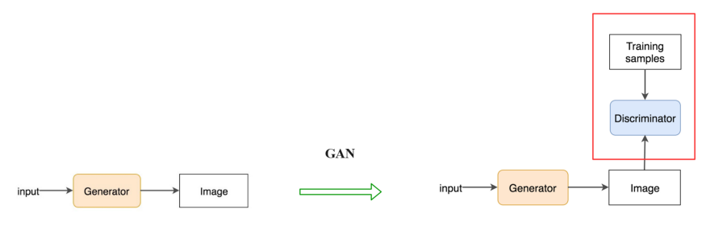
We train both the networks in alternating steps to improve both the networks, eventually the discriminator finds a tiny difference between generated and real images, and the GAN model generates eventually real images.

Slide 8
Simple steps to implement GAN’s
Define the problem
Choose Architecture of GAN
Train Discriminator of Real Data
Generate fake input by generator
Train Discriminator on fake data
Train generator with the output of discriminator

Slide 9
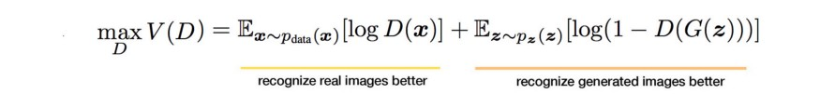
Math behind GAN’s:
When coming to maths behind GAN’s we need to focus on one main topic that is backpropagation, let the discriminator outputs the value D(x) indicating the chance of image being real, our objective is maximize the chance of real image being real and generated image being fake, to measure the loss we generally use cross entropy i.e p log(q). For real images this has to be 1, and for generated images this has to be reverse, so we reverse the label, so the objective becomes:

Slide 10
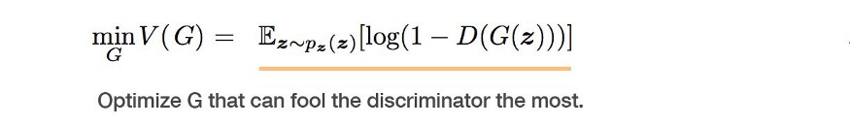
On the generator side, its objective function wants the model to generate images with the highest possible value of D(x) to fool the discriminator.
We can simply tell it as a minmax game where G wants to minimize v while D wants to maximize it.
Once the both objective are decided they are learned jointly by the alternating gradient descent.

Slide 11
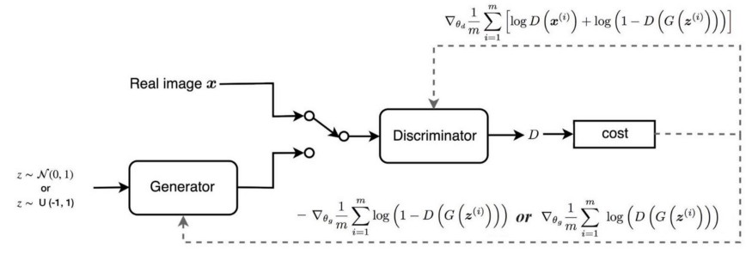
We fix the generator models parameters and perform a single iteration of gradient descent on the discriminator using the real and generated images, the we switch sides fix the discriminator and train the generator for another single iteration. Similarly in this way we train both the networks in alternating steps until the generator produces good quality images, the gradients used for back propagation are:

Slide 12
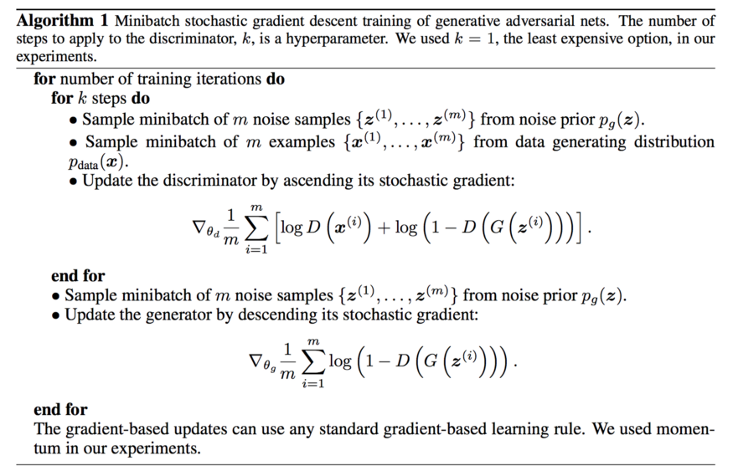
Pseudo code:

Slide 13
Generator diminished gradient:
There will be a gradient descent problem for generator, it is always easier to distinguish the generated images at earlier training, that makes v approaches 0. i.e. - log(1 -D(G(z))) → 0. The gradient for generator will also vanish which makes the gradient descent optimization very slow. To improve that GAN provides alternative function to backpropagate the gradient to the generator.

Slide 14
Types Of GAN’s
Deep Convolutional GANs (DCGANs)
Conditional GANs (cGANs)
StackGAN
InfoGANs
Wasserstein GANs(WGAN)
Discover Cross-Domain Relations with Generative Adversarial Networks(Disco GANS)

Slide 15
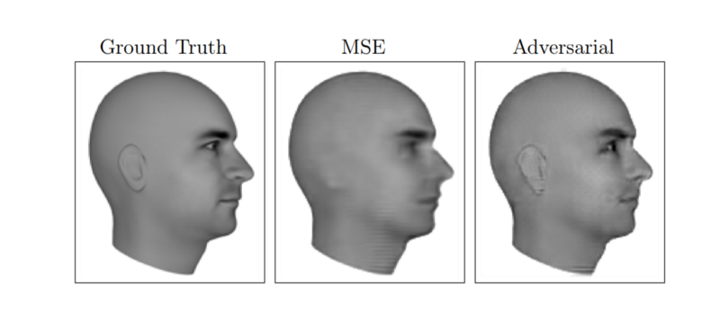
Application of GAN’s
Predicting the next frame in a video.

Slide 16
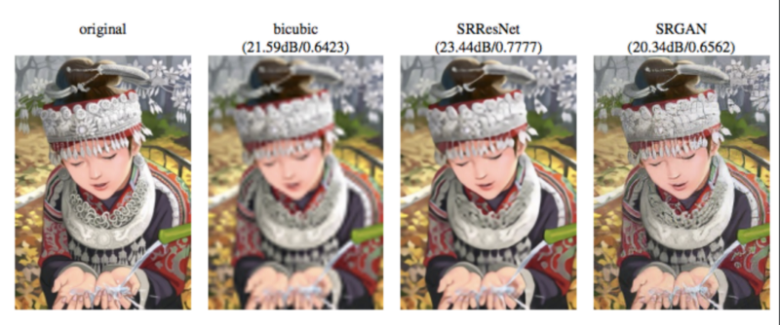
Increasing Resolution of an image.

Slide 17
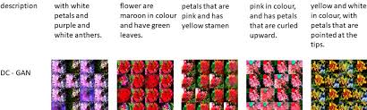
Text-to-Image Generation.

Slide 18
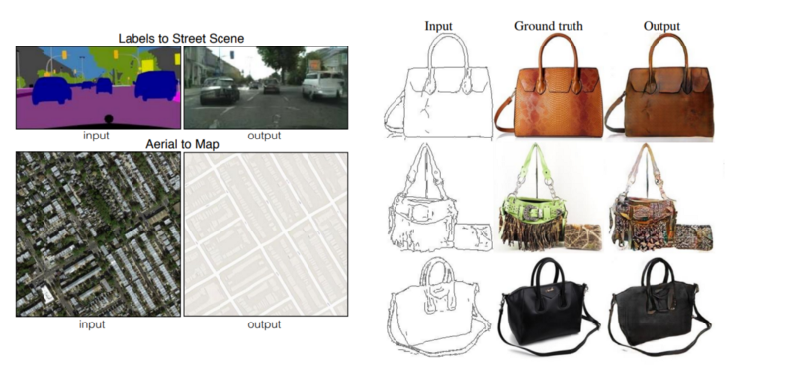
Image to Image Translation

Slide 19
GAN’s using fashion dataset
Code in spyder

Slide 20
References:
https://medium.com/@jonathan_hui/gan-whats-generative-adversarial-networks-and-its-application-f39ed278ef09
https://heartbeat.fritz.ai/introduction-to-generative-adversarial-networks-gans-35ef44f21193

